Slide 1
Cloud library
Team-6
Ganne Tejaswi
Swetha Chandra Karroti
Pallavi Ramineni
Sampoorana Swathi Gorantla

Slide 2



Use case : Library System

Slide 3
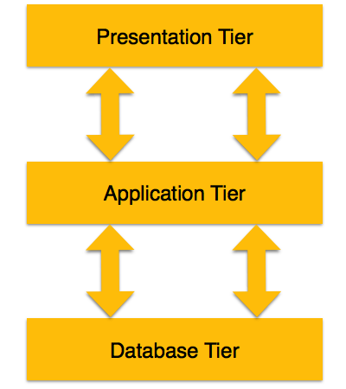
Layered Architecture 1.Presentation tier 2.Application tier 3.Database tier

Slide 4
Architecture diagram

Slide 5
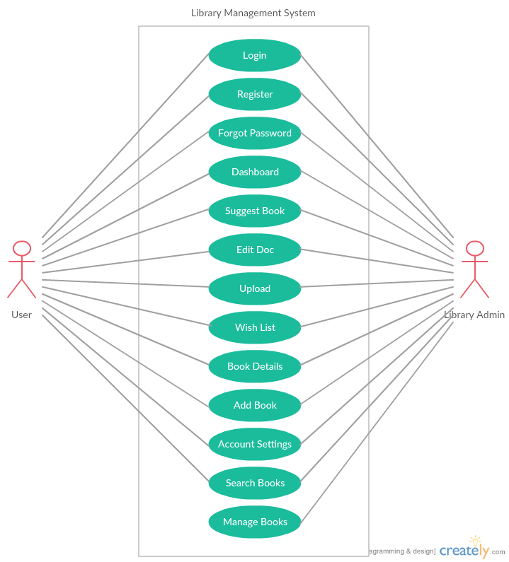
Uml use case

Slide 6
Uml class diagram

Slide 7
Sequence Diagram

Slide 8
Sequence diagram

Slide 9
Sequence diagrams

Slide 10
Design pattern
A combination of Observer Pattern and Abstract Factory pattern can be used.
Observer Pattern: Software Design Pattern in which an object, maintains a list of its dependents, called observers, and notifies them automatically of any state changes.
Abstract Factory Pattern: The essence of this pattern is to provide an interface for creating families of related or dependent objects without specifying their concrete classes.

Slide 11


